Slide 1
“A Very Old Man with Enormous Wings”

Slide 2
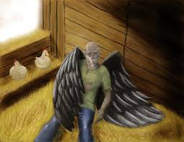
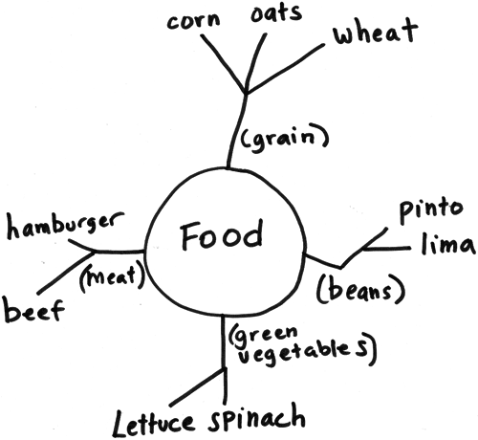
Exploring Archetypes
Create a word web for each of
the following:
Wings
Angel
Old Man

Slide 3
Cold Passage: “A Very Old Man With Enormous Wings: A Tale for Children”
Reading Goals
ANNOTATE as you read for the following:
Examine archetypes within the story: are there any “stock” characters? How do they function? (Provide evidence)
Write two potential theme statements for “A Very Old Man with Enormous Wings”
Are there any quest elements within the story? What can you find?

